Slide 1
Acid Rain

Slide 2
Learning Outcomes
The causes of acid rain.
Understand how acid rain can affect rocks, living things and buildings.
Have an idea of how acid rain is formed.

Slide 3

What is acid rain?
can you say some things about acid rain using these headlines to help you…

Slide 4
What is Acid Rain?
When a fuel burns, it produces poisonous gases such as sulphur dioxide.
The sulphur dioxide dissolves in the clouds and then causes rain. This is acid rain.
Sometimes when it rains you can smell an eggy smell, this will be because of sulphur.

Slide 5
Acid Rain
Precipitation that has a pH of less than that of natural rainwater (which is about 5.6) due to dissolved oxides of Sulphur, nitrogen and carbon.
It is formed when oxides of Sulphur, carbon and nitrogen, as gases or fine particles in the atmosphere, combine with water vapor and precipitate as sulphuric , carbonic or nitric acids in rain, snow, or fog.

Slide 6
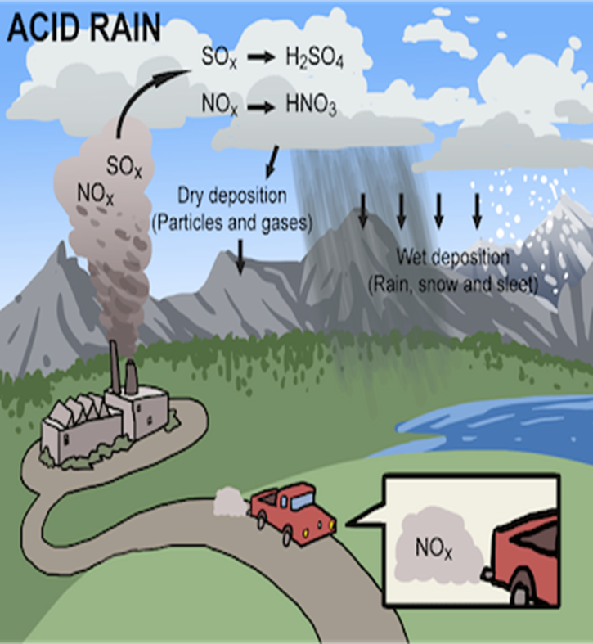

Slide 7
S
O
O
S
S
O
O
S
O
O
S
O
O
S
SULFURIC ACID
O
O
S
O
O
O
O
S
O
O
ACID RAIN
ACID RAIN
ACID RAIN
ACID RAIN

Slide 8
Acid Rain formation

Slide 9
Acid Rain Formation
When water vapor condenses, or as the rain falls, they dissolve in the water to form sulphuric acid (H2SO4) and nitric acid (HNO3).
in this way, it causes precipitation to become acidic, forming acid rain

Slide 10
Chemical Equations
The following reaction will clarify the acid formation reaction:-
H2O (l) + CO2 (g) ⇌ H2CO3 (aq)
2SO2 (g) + O2 (g) + 2H2O (l) → 2H2SO4 (aq)
4NO2 (g) + O2 (g) + 2H2O (l) → 4HNO3 (aq)

Slide 11
Effects of Acid Rain
the following pictures are a stimulus to explain what effects acid rain causes on the environment.

Slide 12
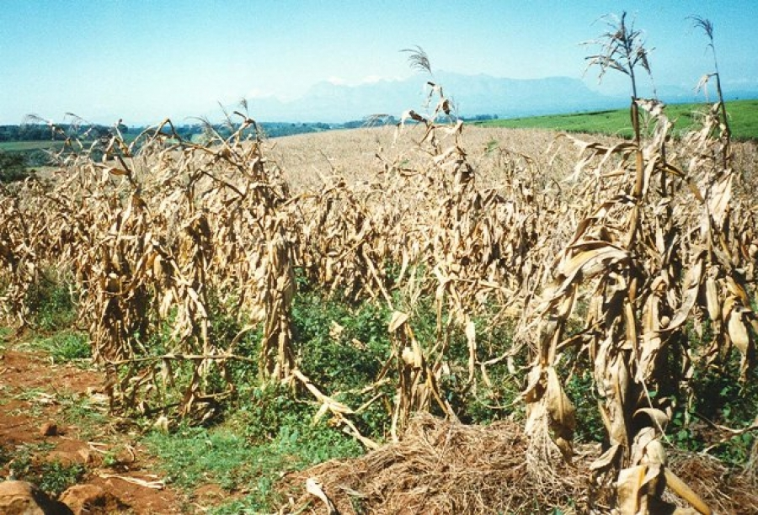

Slide 13
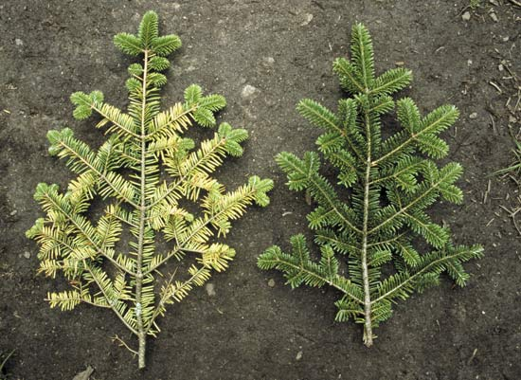

Slide 14
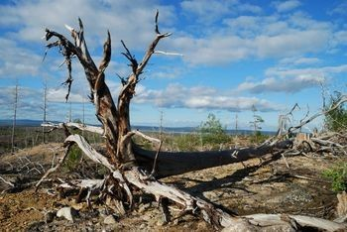

Slide 15
It has been shown that acid rain has detrimental effects on trees, freshwaters and soils, destroys insects and aquatic life-forms.
Causes paint to peel, corrosion of steel structures such as bridges, and weathering of stone buildings and historic sculptures as well as impacts on human health.
Acid rain also causes aluminum to be released into the soil, which makes it difficult for trees to take up water.

Slide 16
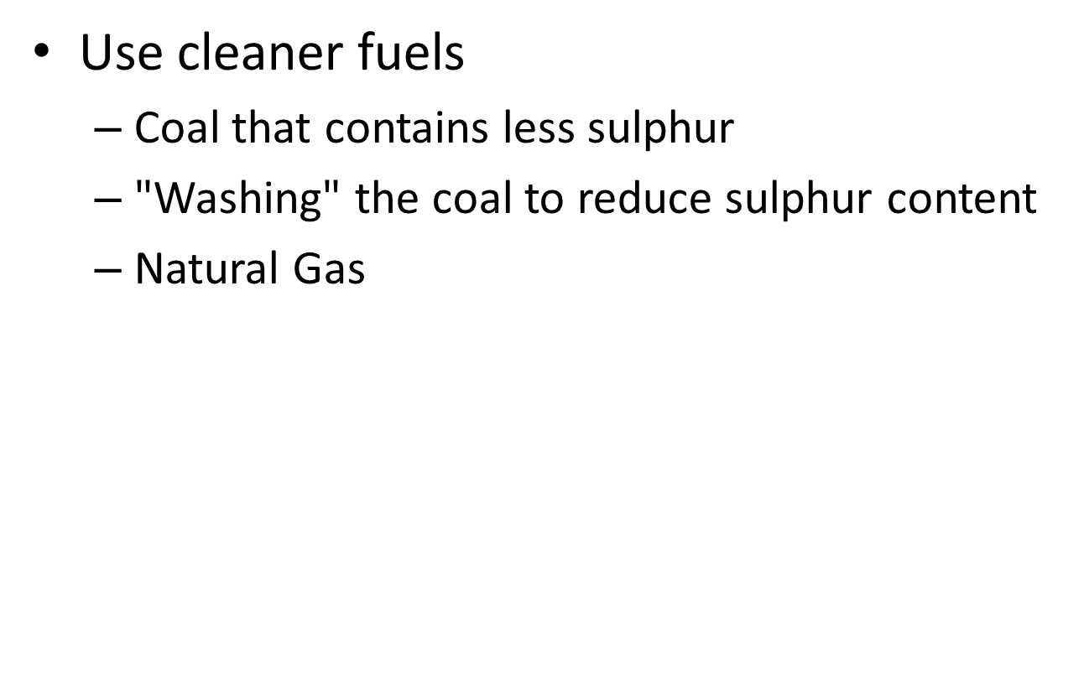

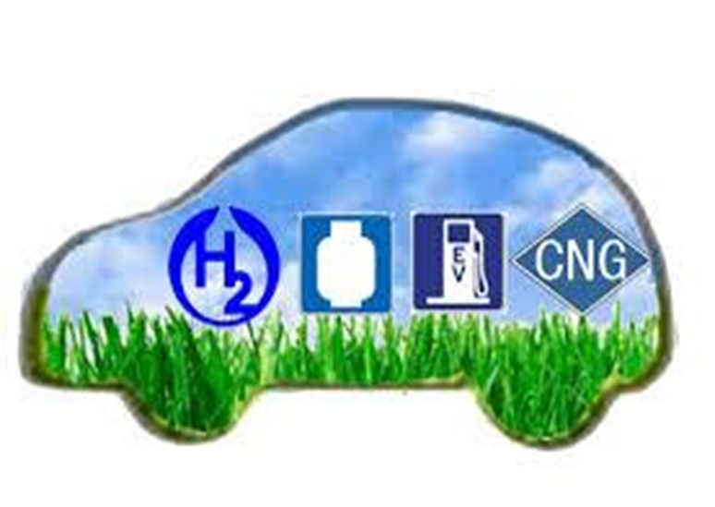
Preventive Measures

Slide 17
Preventive Measures
Liming
Powdered limestone/limewater added to water and soil to neutralize acid, used extensively in Norway and Sweden, its an expensive, short-term remedy

Slide 18
References
https://en.wikipedia.org/wiki/Acid_rain
https://byjus.com/chemistry/acid-rain/
https://www.usgs.gov/special-topics/water-science school/science/acid-rain-and-water
https://www.britannica.com/science/acid-rain
https://www.nationalgeographic.com/environment/article/acid-rain
https://dec.ny.gov/environmental-protection/acid-rain

Slide 19
THANK YOU FOR
YOUR ATTENTION!

